Slide 1
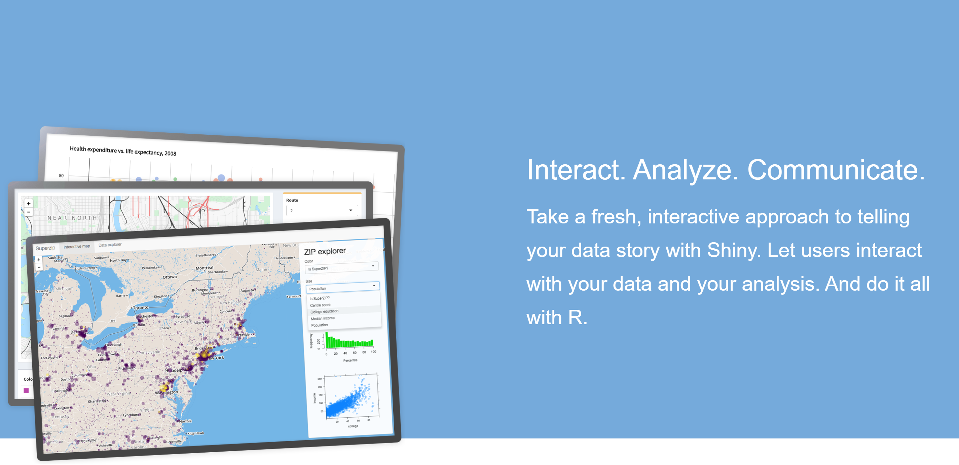
Shiny for web apps
“Shiny is an R package that makes it easy to build interactive web apps straight from R. You can host standalone apps on a webpage or embed them in R Markdown documents or build dashboards. You can also extend your Shiny apps with CSS themes, htmlwidgets, and JavaScript actions.”

Slide 2
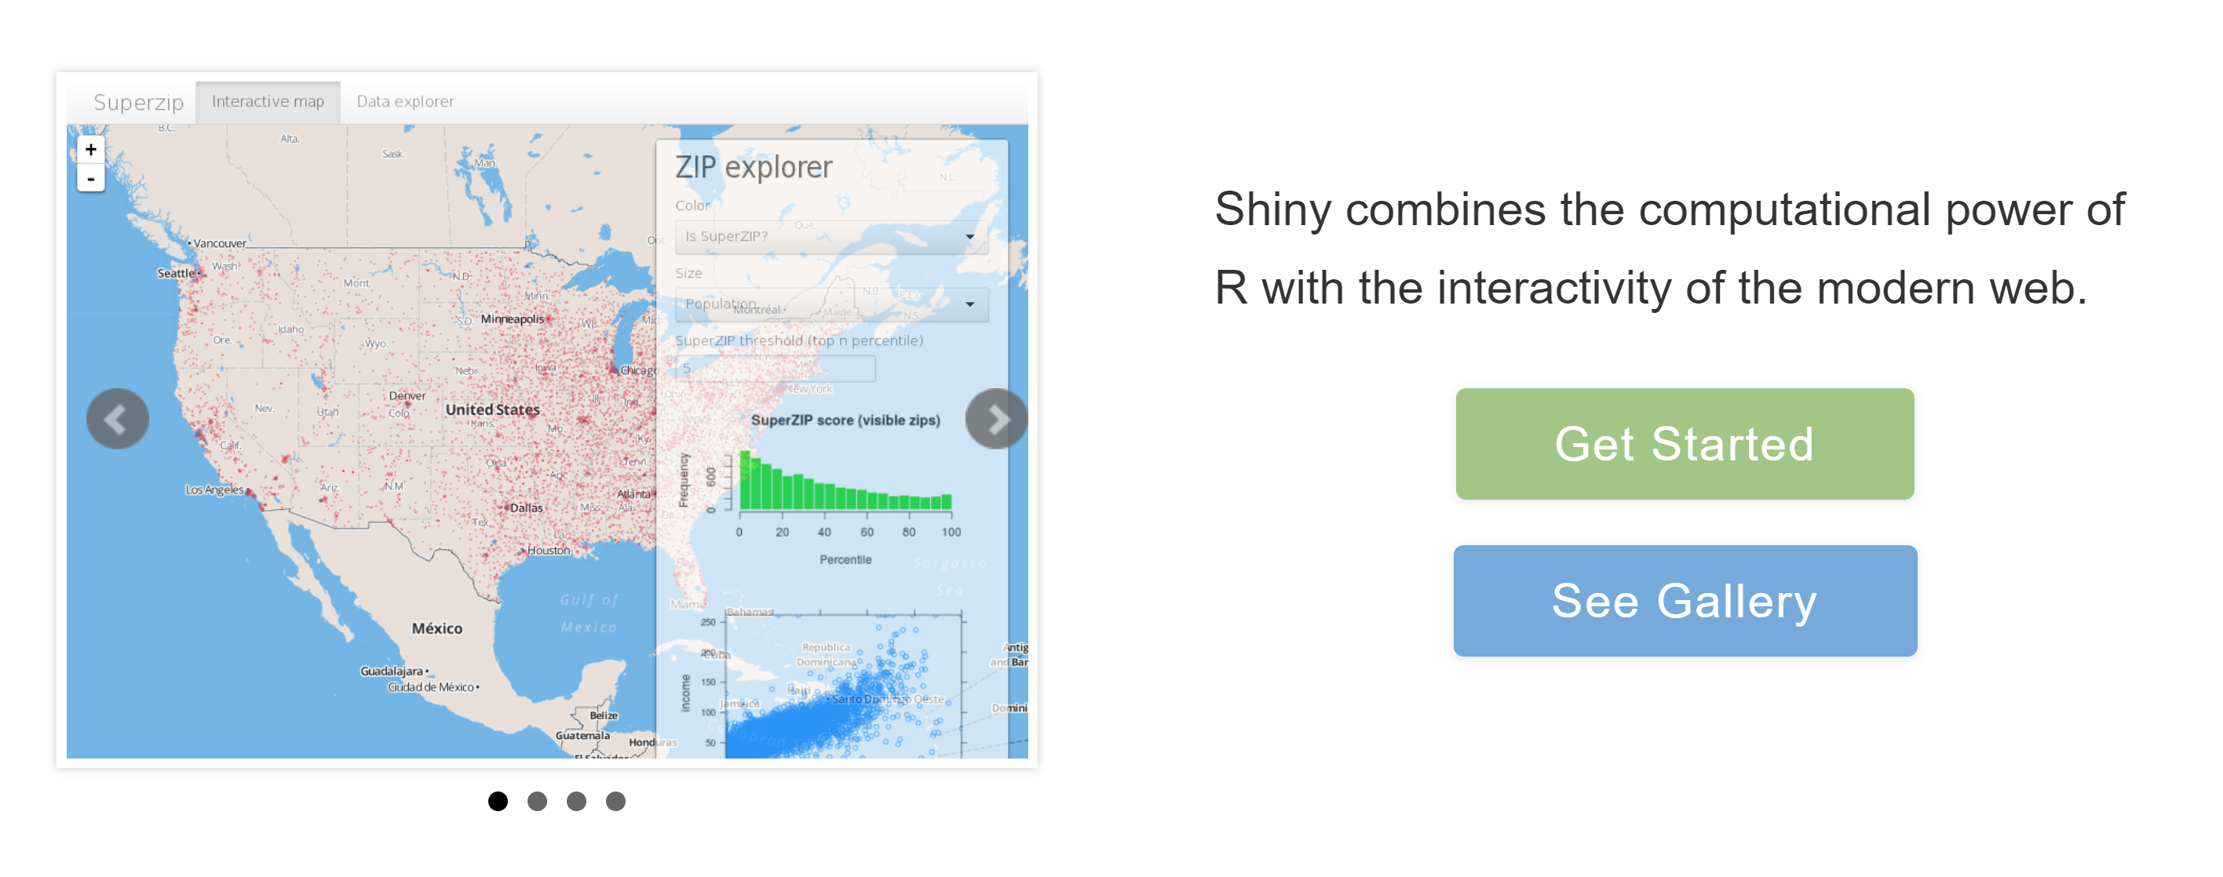
Source: https://shiny.rstudio.com/

Slide 3
Demo and in-class practices
Week12
App1
App2

Slide 4
A new web tool to inform urban forest conservation and restoration
Yang Shao, Department of Geography, Virginia Tech
Daniel McLaughlin, Department of Forest Resources and Environmental Conservation, Virginia Tech
Heng Wan, Department of Geography, Virginia Tech
Brian van Eerden, The Nature Conservancy

Slide 5
Outline
Introduction (project background)
Web tool and its implementation

Slide 6
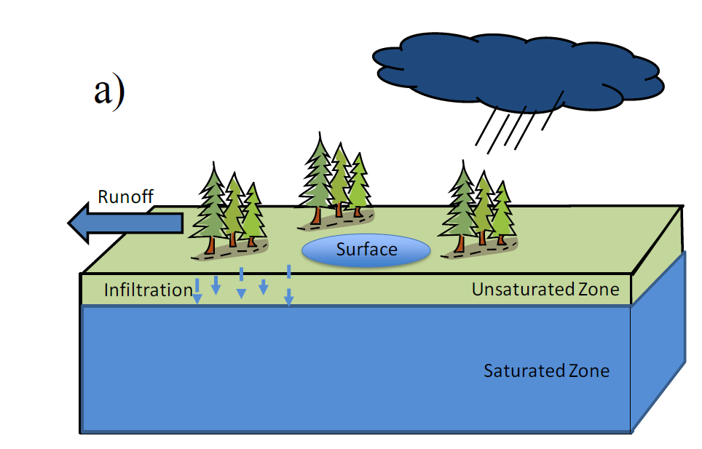
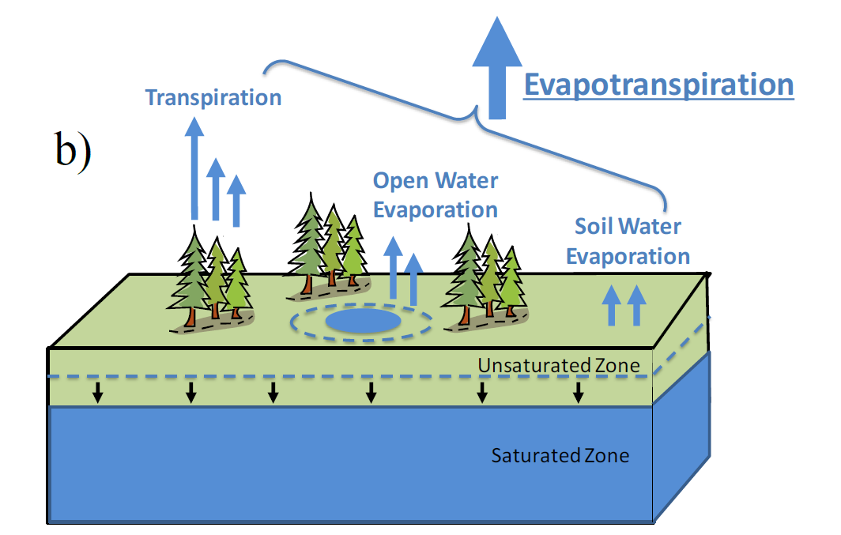
Urban forest, ecosystem services, and conservation
Conservation of urban forests are potentially significant tools for:
Building energy savings
Air pollutant reduction
Carbon dioxide sequestration
Flood risk reduction
…
Green infrastructure (e.g. forests) play a role in stormwater and flood management
a) Water storage services during precipitation events, where depressions accumulate and store surface water (i.e., depressional surface water storage; soils infiltrate and store water in soil pores. b) Evapotranspiration (ET) provides water removal services and reduces standing surface water, depletes soil moisture, and lowers the water table (i.e., top of the saturated zone).

Slide 7
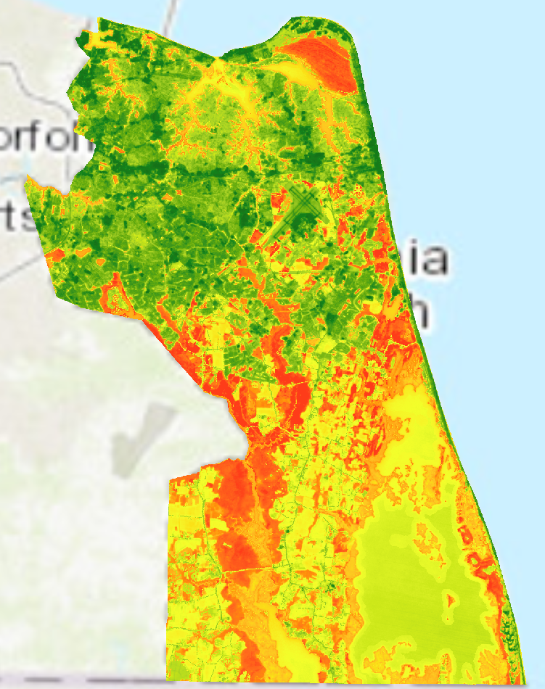
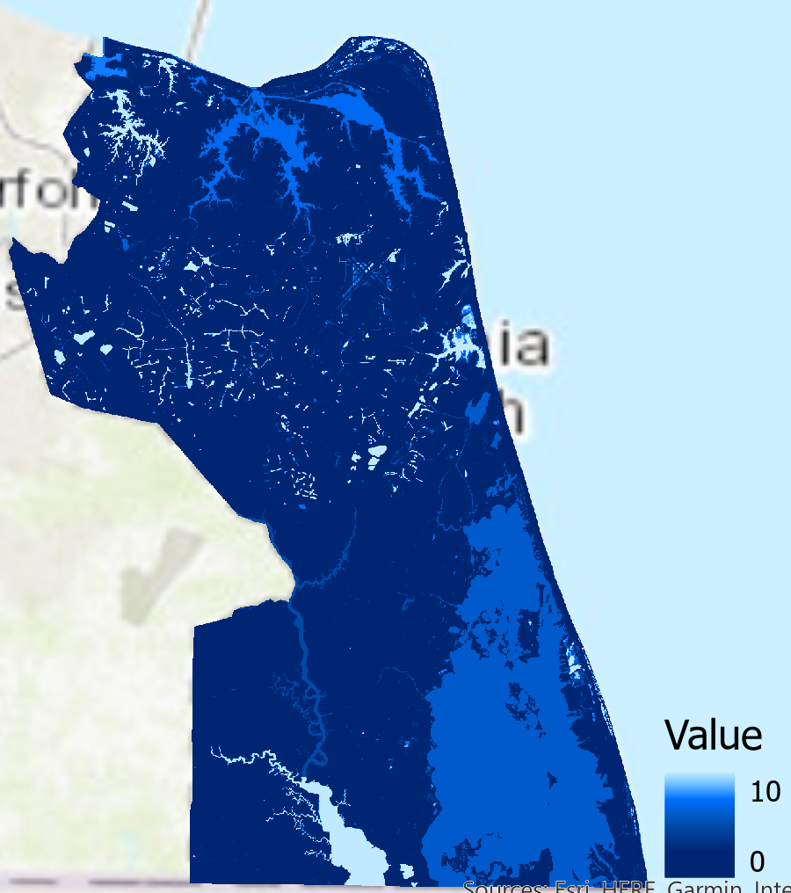
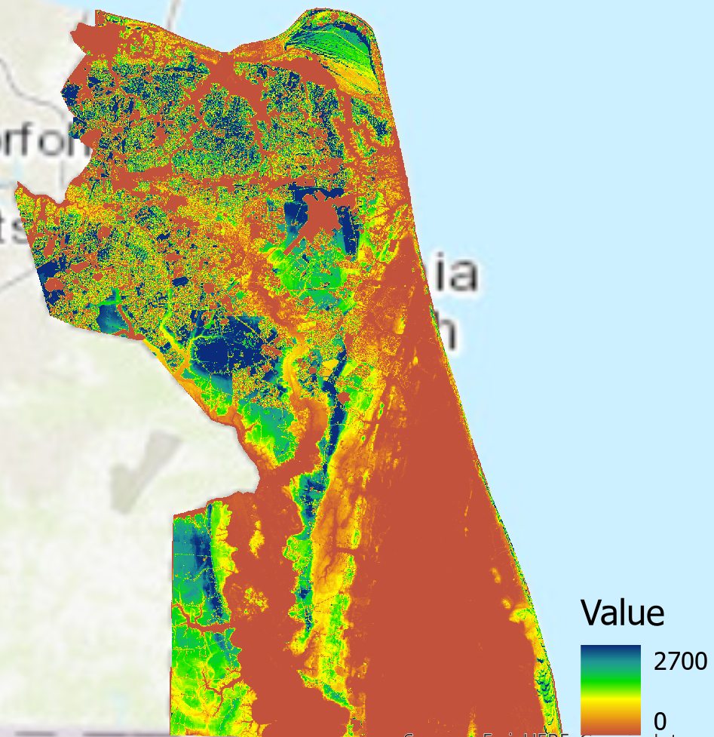
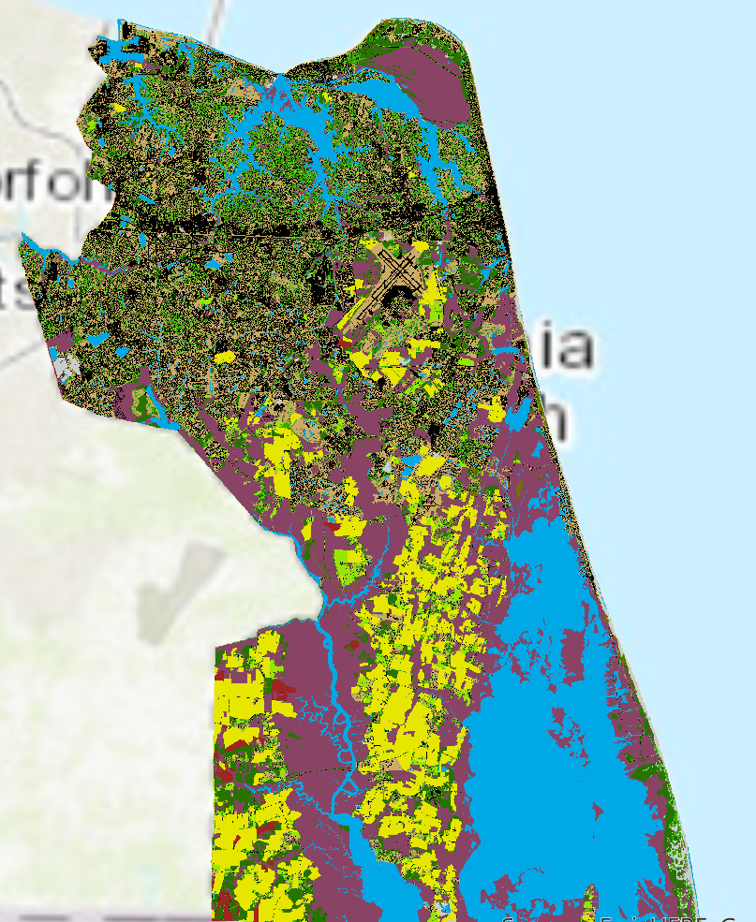
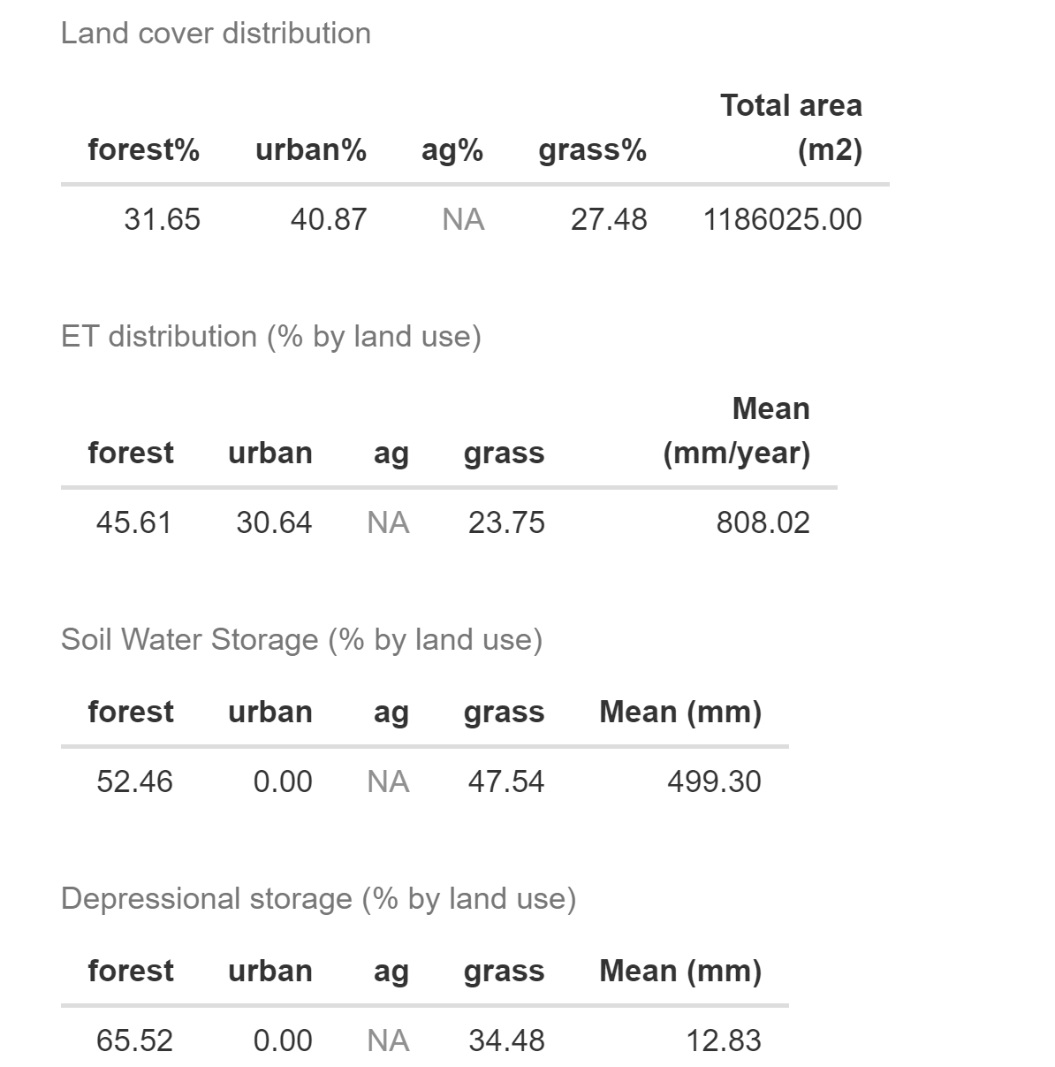
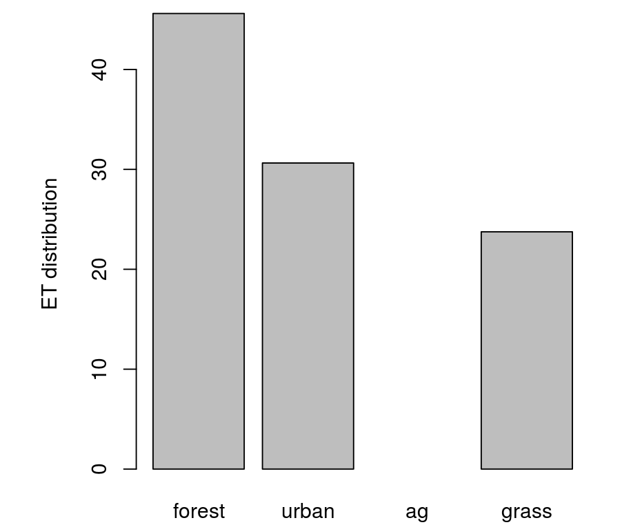
Conservation of urban forests for Flood Reduction Services
Evapotranspiration (ET)
Depression Storage
Soil Water Storage
Land cover
User defined polygon
Interactive web experience to inform management decisions

Slide 8
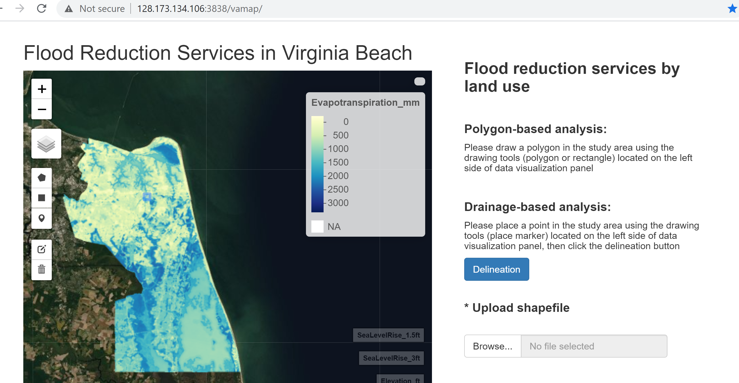
Web tool (version 1)

Slide 9
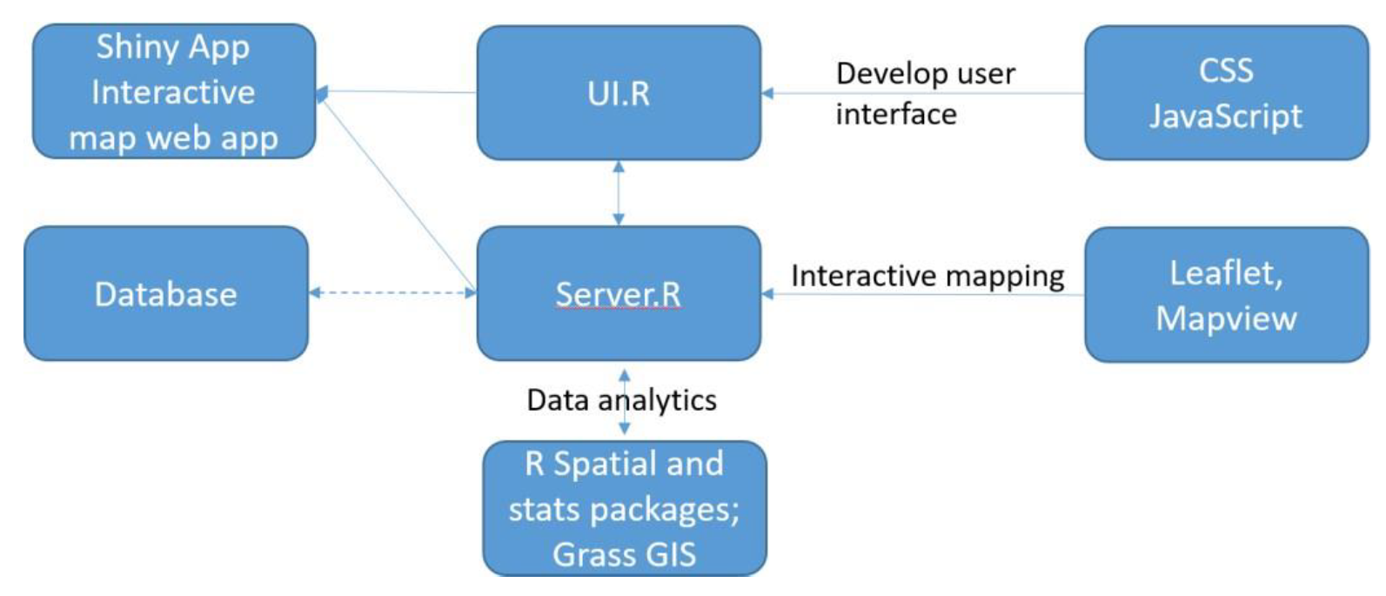
Web Tool Implementation
Open Source software packages
The web tool was mainly developed using the R Shiny library from Rstudio
Various R libraries (e.g., rgdal, raster) for data analytics
Hydrological modeling capabilities (e.g., flow accumulation) are channeled from GRASS
The tool is now deployed through a Shiny Server installed on the Ubuntu machine

Slide 10
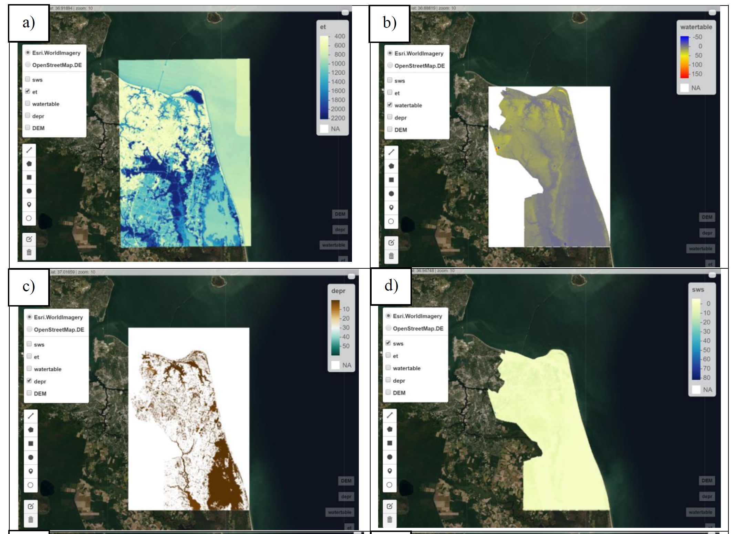
Visualization of geospatial data layers

Slide 11
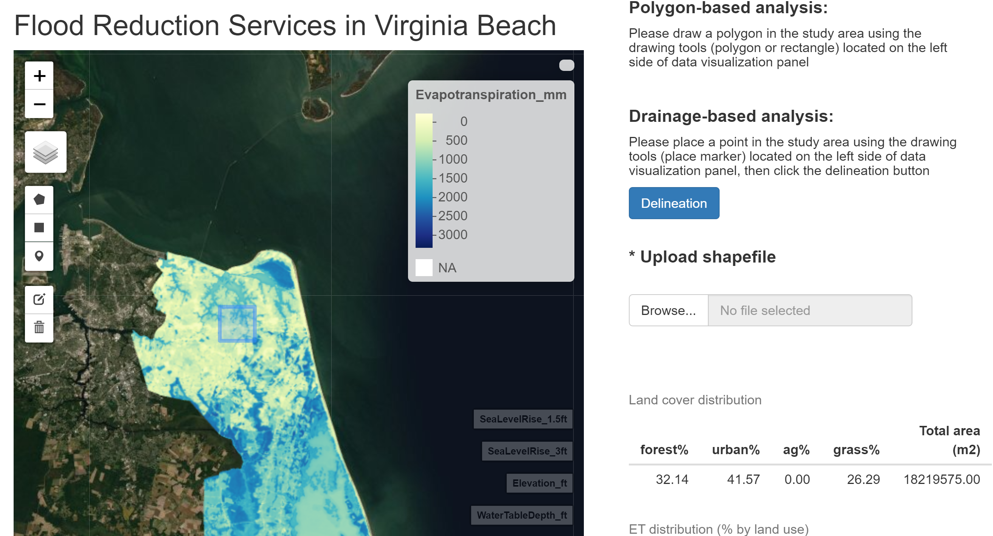
Polygon-based analysis of land covers and associated flood reduction services

Slide 12
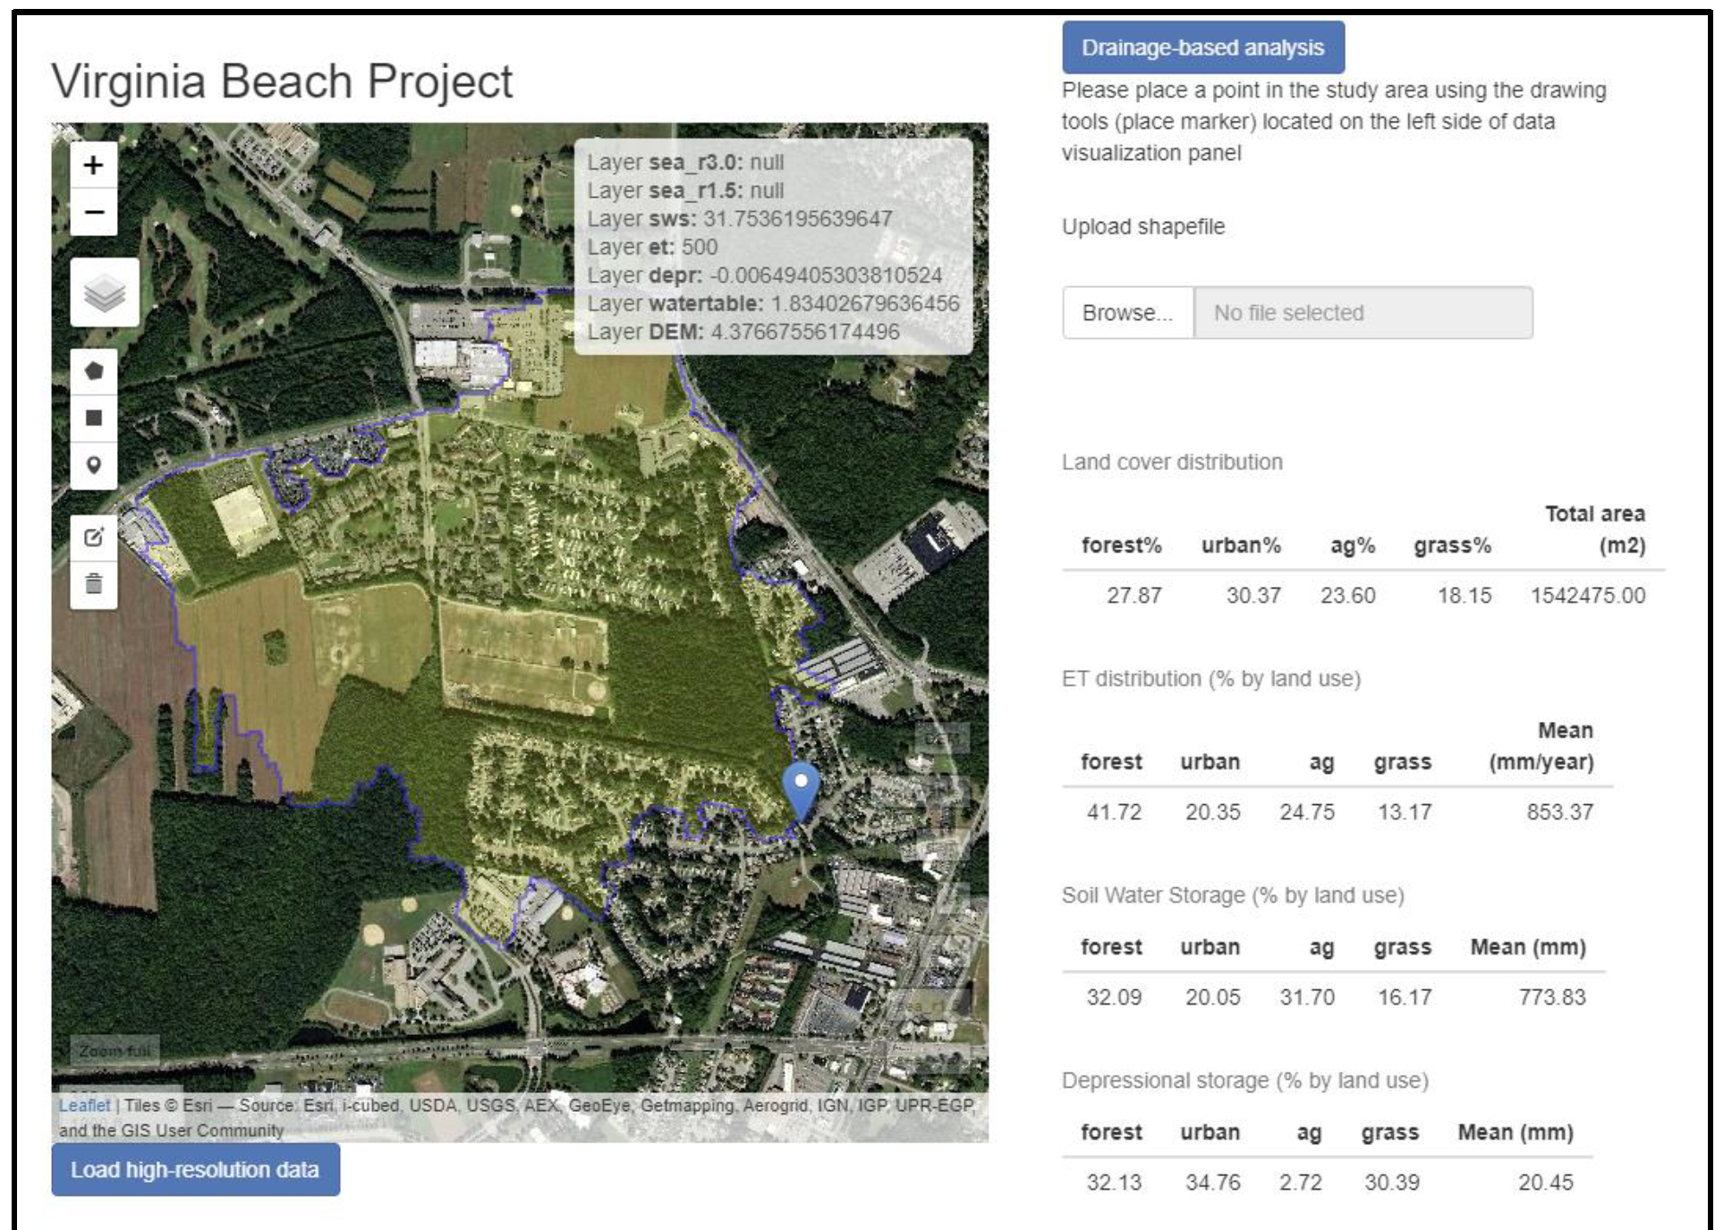
Drainage-based analysis of land cover and flood reduction services

Slide 13
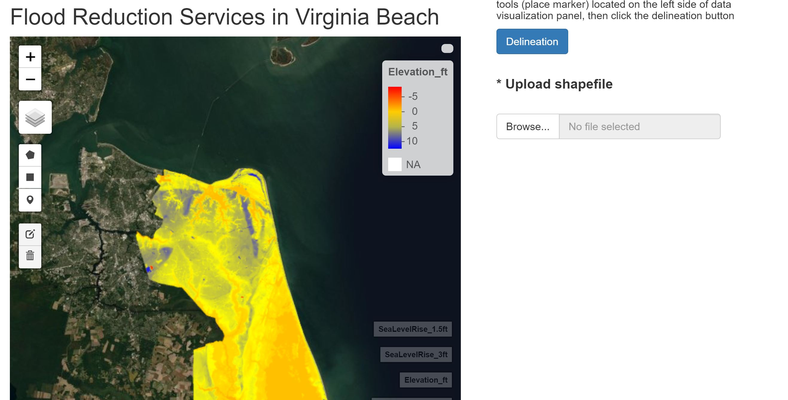
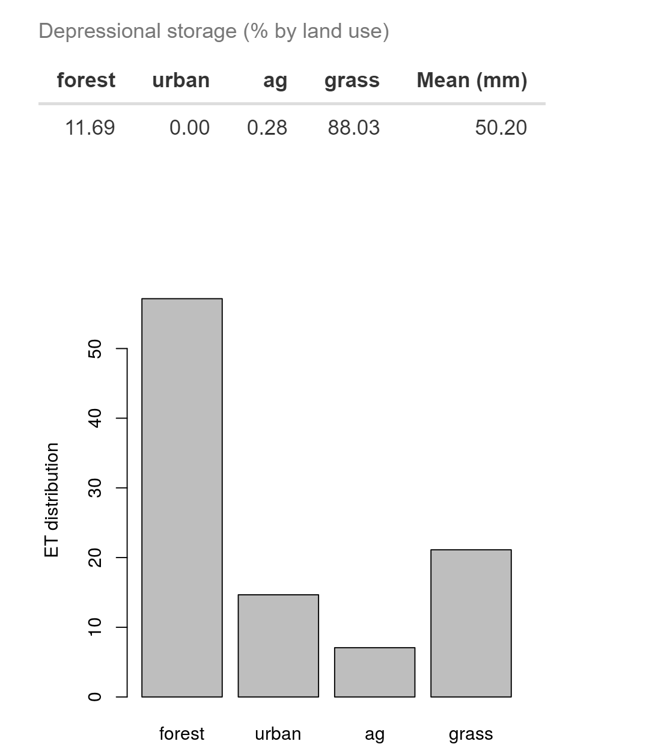

Slide 14


Web tool users
This web tool enables easy visualization of various geospatial data layers and full integration with powerful geospatial/hydrological analytics at the back-end server.
The web tool is now assessed by project collaborators and land managers, urban planners, and other decision makers (The Nature Conservancy, City of Virginia Beach)

Slide 15
Hosting Shiny applications
“RStudio Connect and shinyapps.io are both products used to share content created by R users. They both have features that make hosting Shiny applications a great end user experience, so choosing between them depends on what you want to publish and how you want to it published.”

Slide 16
Install shiny server - Ubuntu
Step1:
Setup the Linux Server in Azure or Amazon Cloud (see lecture note 17)
Step2: install r-base, Shiny R package, and then Shiny-server
install.packages('shiny', repos='https://cran.rstudio.com/')
sudo apt-get install gdebi-core
wget https://download3.rstudio.org/ubuntu-14.04/x86_64/shiny-server-1.5.12.933-amd64.deb sudo
sudo gdebi shiny-server-1.5.12.933-amd64.deb
Source:https://rstudio.com/products/shiny/download-server/ubuntu/

Slide 17
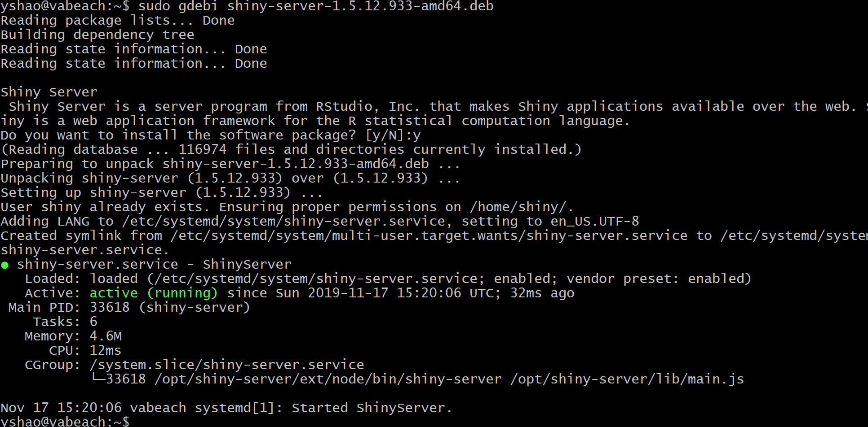

Slide 18
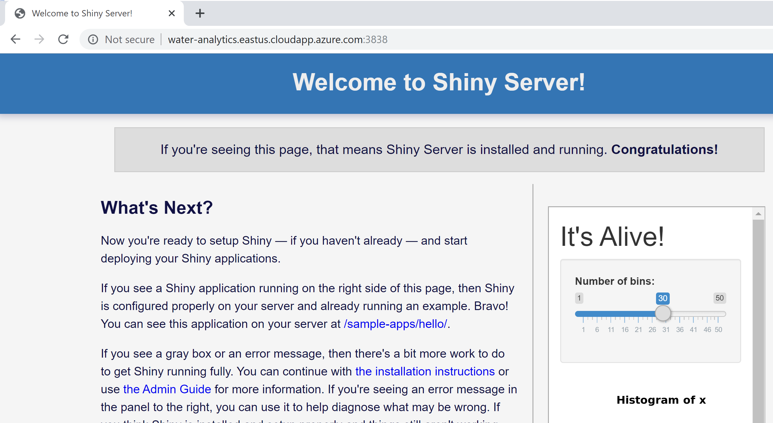

Slide 19
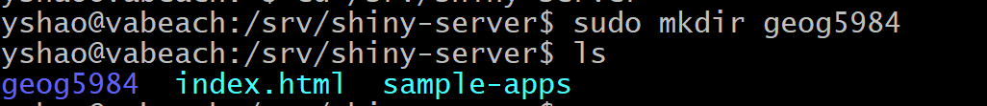
Change directory to /srv/shiny-server
Make a new directory (geog5984) within shiny-server folder

Slide 20
Copy app.R and www data folder (you may use Filezilla uploading them to azure Ubuntu machine)
After uploading:
sudo cp app.R /srv/shiny-server/geog5984
sudo cp –r www /srv/shiny-server/geog5984

Slide 21
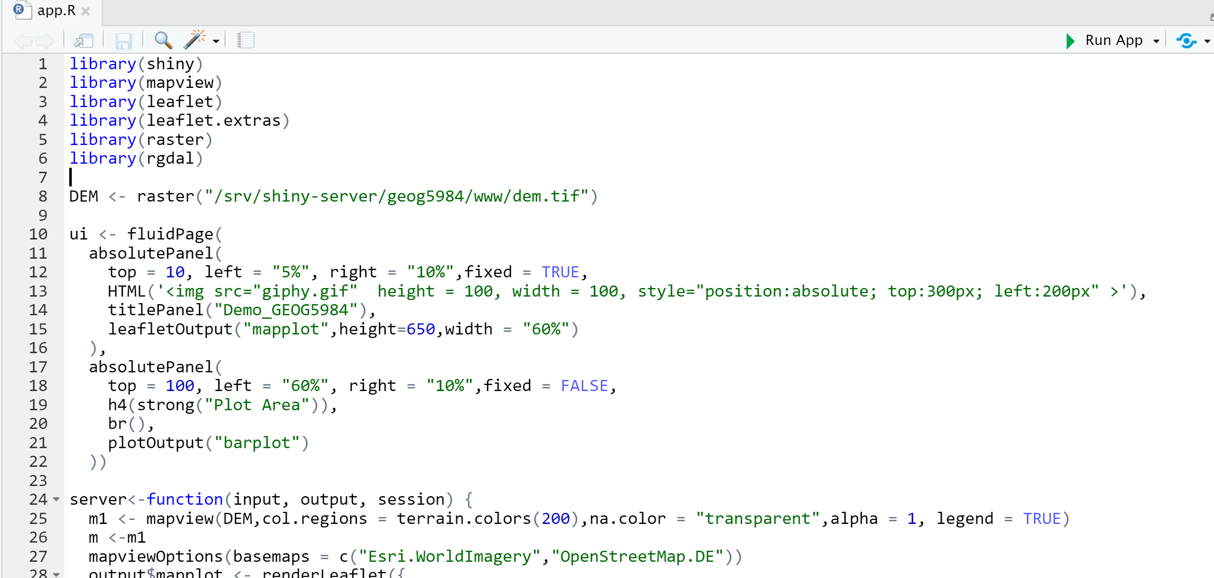

Slide 22
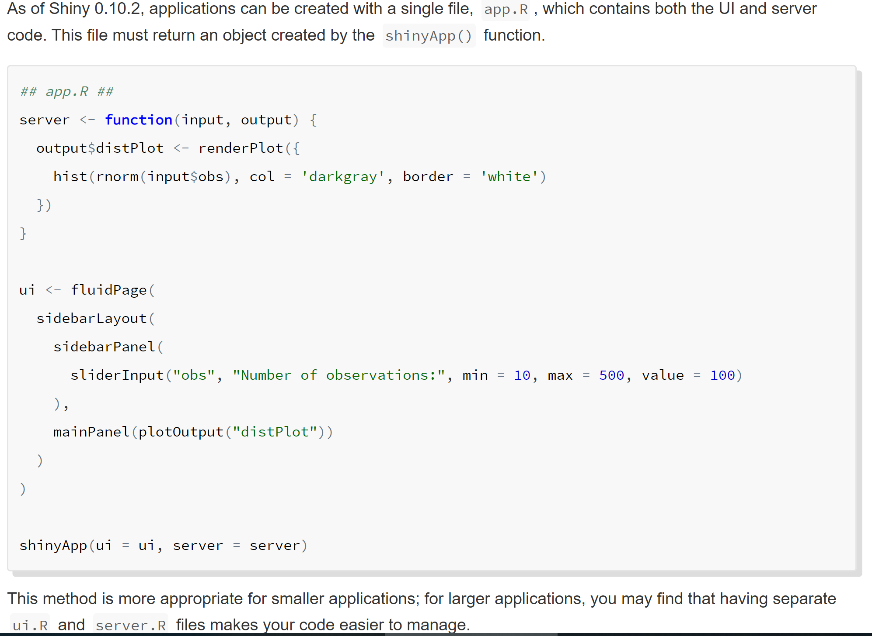

Slide 23
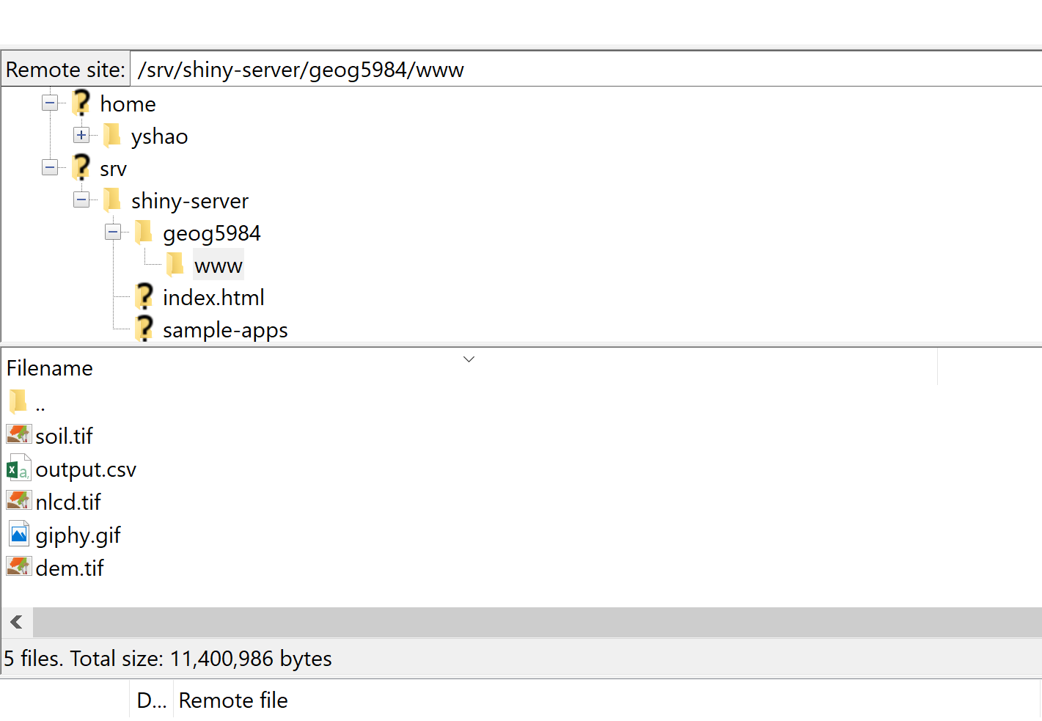

Slide 24
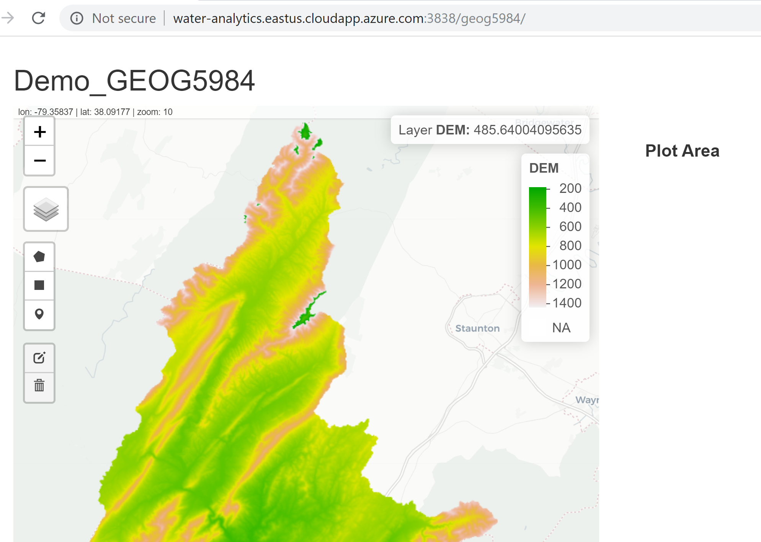

Slide 25
